Slide 1
DATABASE ANALYSIS Session 10
Course : ISYS6280 – Database Systems (GAT)
Year : 2015

Slide 2
LEARNING OUTCOME
LO 1: Describe database systems, terminology, environment, and new concept of database

Slide 3
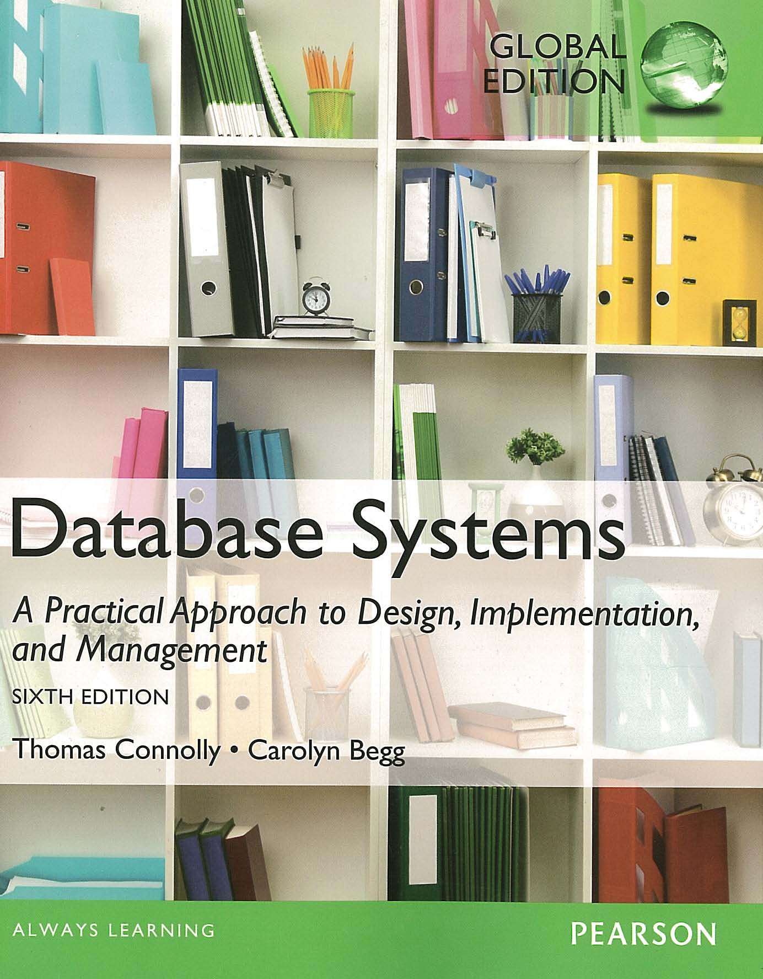
ACKNOWLEDGEMENT
These slides have been adapted from Thomas Connolly and Carolyn Begg. 2015. Database Systems: A Practical Approach To Design, Implementation, and Management. Pearson Education. USA. ISBN:978-1-292-06118-4

Slide 4
CHAPTER 11 DATABASE ANALYSIS

Slide 5
LEARNING OBJECTIVES
When fact-finding techniques are used in the database application lifecycle.
The types of facts collected in each stage of the database application lifecycle.
The types of documentation produced in each stage of the database application lifecycle.
The most commonly used fact-finding techniques.
How to use each fact-finding technique and the advantages and disadvantages of each.
About a property rental company called DreamHome.
How to apply fact-finding techniques to the early stages of the database application lifecycle.

Slide 6

Fact-finding techniques
It is critical to capture the necessary facts to build the required database application.
These facts are captured using fact-finding techniques.
The formal process of using techniques such as interviews and questionnaires to collect facts about systems, requirements, and preferences.
museumperdamaian.org

Slide 7

When Are Fact-Finding Techniques Used?
Fact-finding used throughout the database application lifecycle. Crucial to the early stages including database planning, system definition, and requirements collection and analysis stages.
Enables developer to learn about the terminology, problems, opportunities, constraints, requirements, and priorities of the organization and the users of the system.
techpatio.com

Slide 8

Fact-Finding Techniques
A database developer normally uses several fact-finding techniques during a single database project including:
examining documentation
interviewing
observing the organization in operation
research
questionnaires
x.vceinc.com

Slide 9

Examining documentation
www.vidyaweb.in
To gain some insight as to how the need for a database arose.
To identify the part of the organization associated with the problem.
To understand the current system.

Slide 10
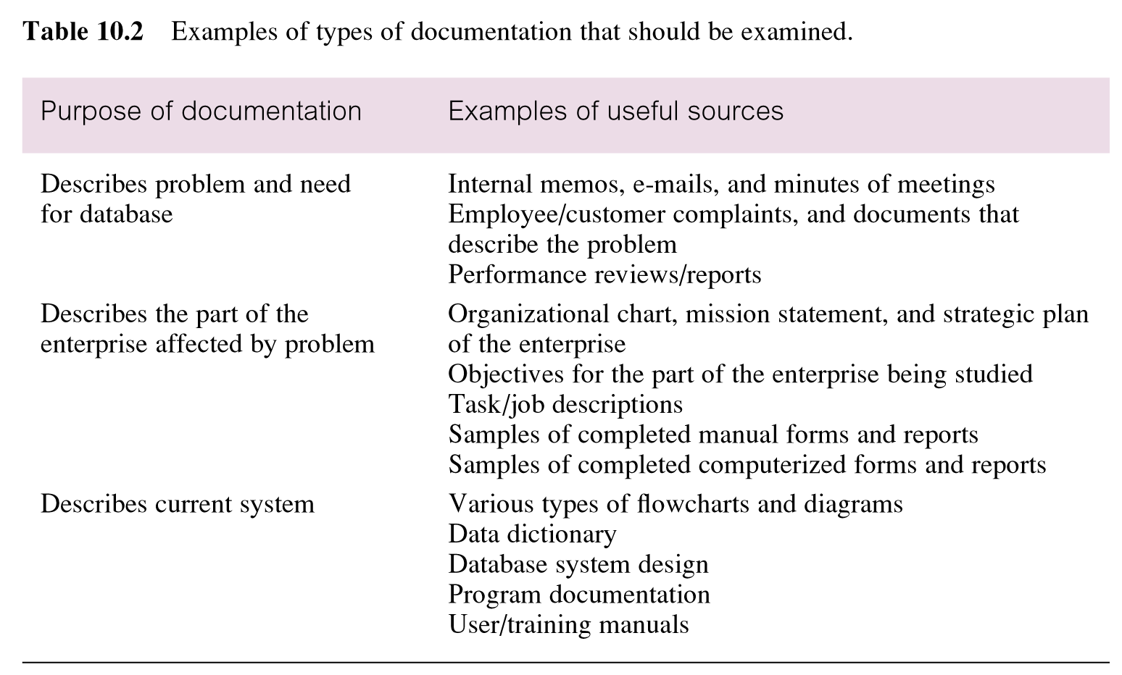
Examples of types of documentation that should be examined

Slide 11

Interviewing
Most commonly used, and normally most useful, fact-finding technique. Enables collection of information from individuals face-to-face.
Objectives include finding out facts, verifying facts, clarifying facts, generating enthusiasm, getting the end-user involved, identifying requirements, and gathering ideas and opinions
www.executiveplacementsofva.com

Slide 12
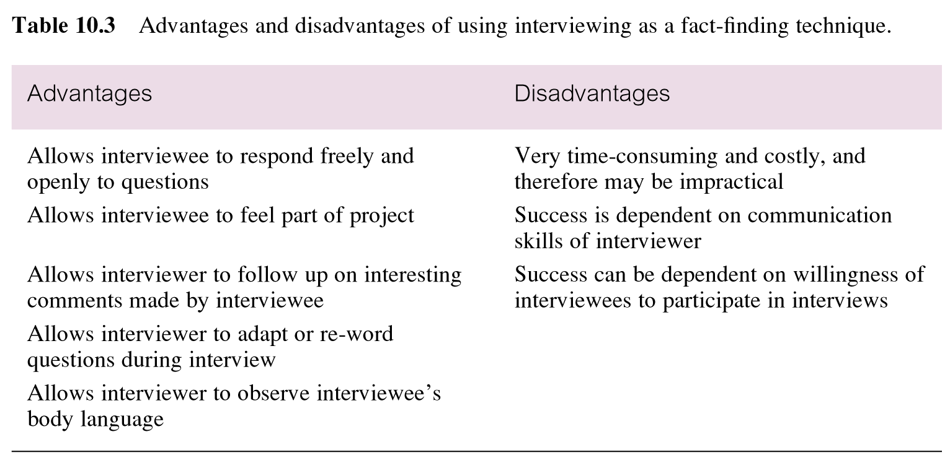
Advantages and disadvantages of interviewing

Slide 13
Interviewing : two types of interviews
Unstructured
Conducted with only a general objective in mind and with view, if any, specific questions
Structured
Specific questions to ask
Closed-ended question (restrict answers to either specific choices or short, direct responses. )
Open-ended questions (allow the interviewee to respond in any way that seems appropriate)

Slide 14
Observing the Organization in Operation
An effective technique for understanding a system.
Possible to either participate in, or watch, a person perform activities to learn about the system.
Useful when validity of data collected is in question or when the complexity of certain aspects of the system prevents a clear explanation by the end-users.

Slide 15
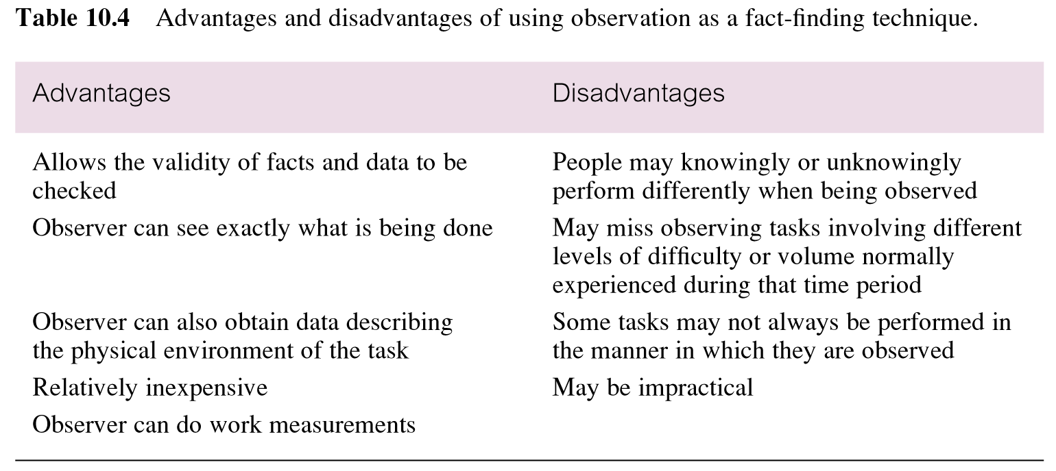
Advantages and disadvantages of using observation

Slide 16
Research
Useful to research the application and problem.
Use computer trade journals, reference books, and the Internet (including user groups and bulletin boards).
Provide information on how others have solved similar problems, plus whether or not software packages exist to solve or even partially solve the problem.

Slide 17
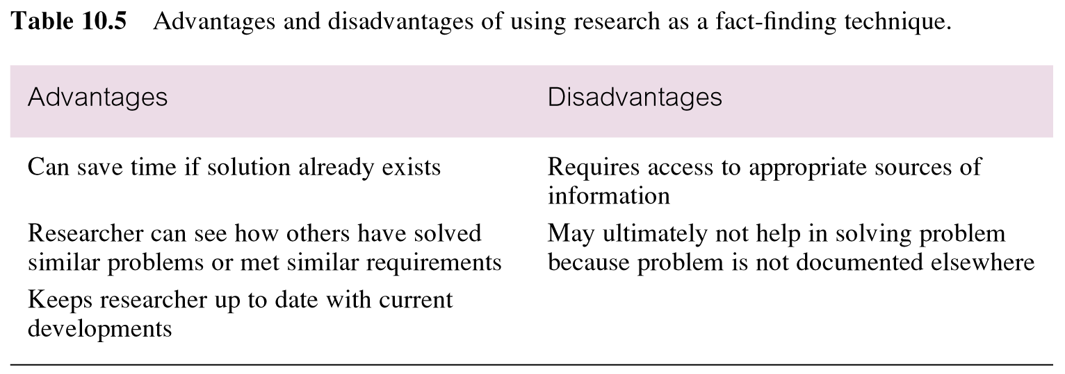
Advantages and disadvantages of using research

Slide 18

Questionnaires
Conduct surveys through questionnaires, which are special-purpose documents that allow facts to be gathered from a large number of people while maintaining some control over their responses.
There are two types of questions, namely free-format and fixed-format.
research-methodology.net

Slide 19
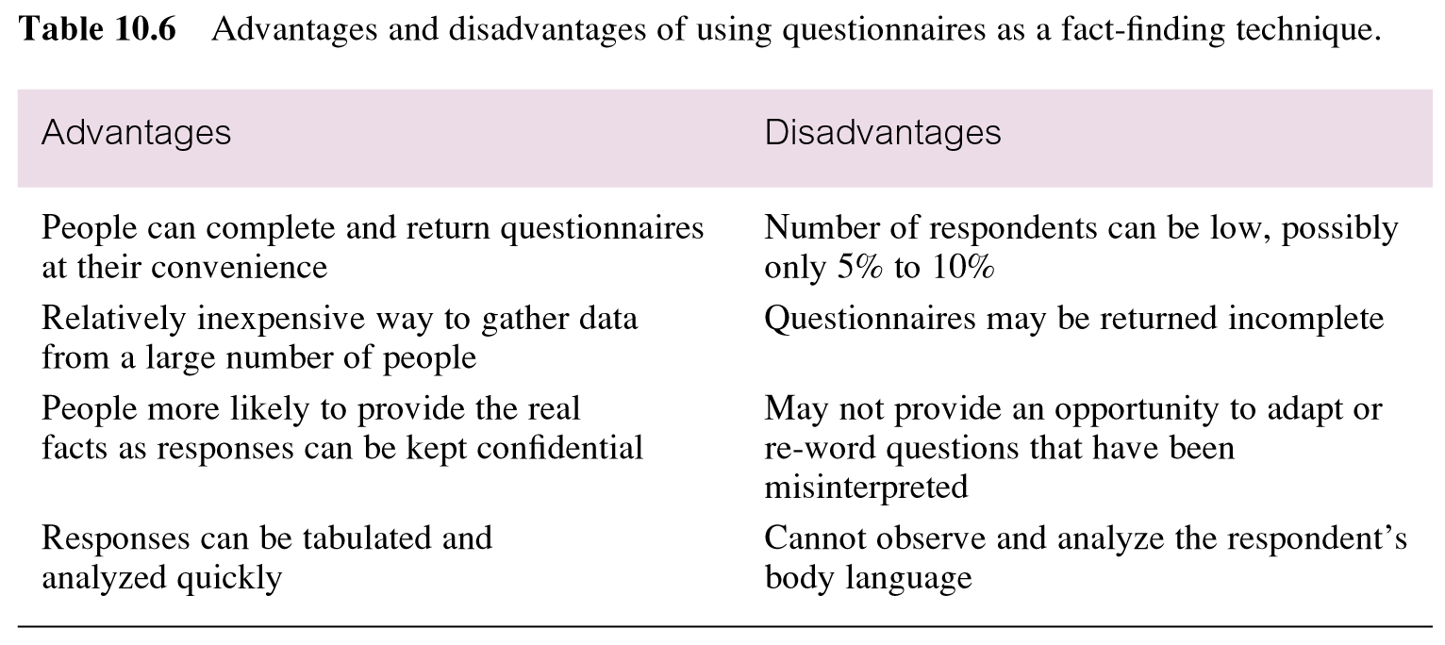
Advantages and disadvantages of using questionnaires

Slide 20
Using Fact-Finding Techniques – A Worked Example

Slide 21
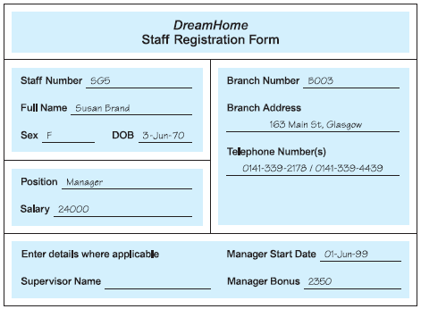
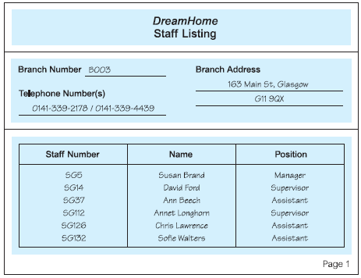

Slide 22
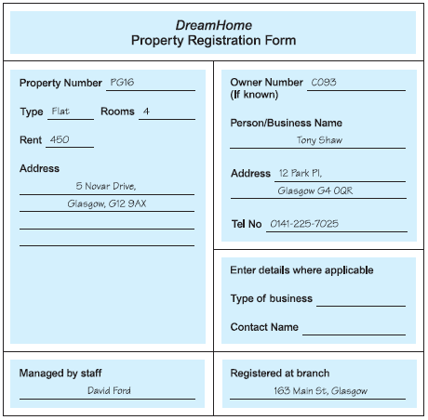
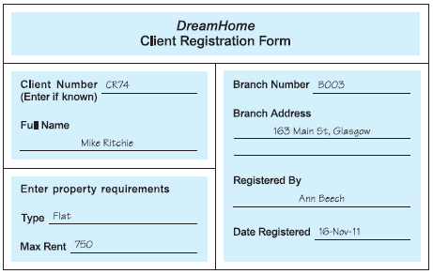

Slide 23

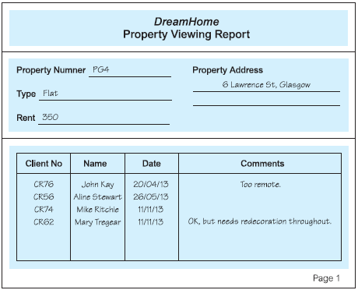

Slide 24
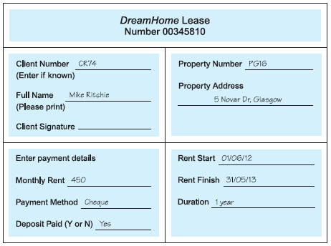

Slide 25
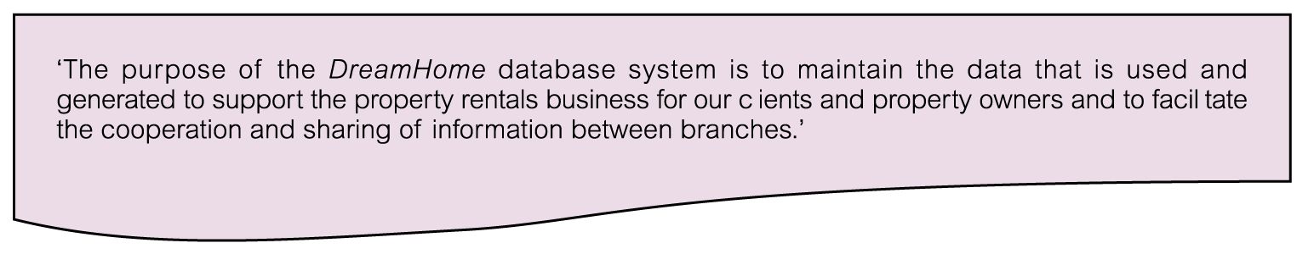
Mission Statement for DreamHome Database System

Slide 26
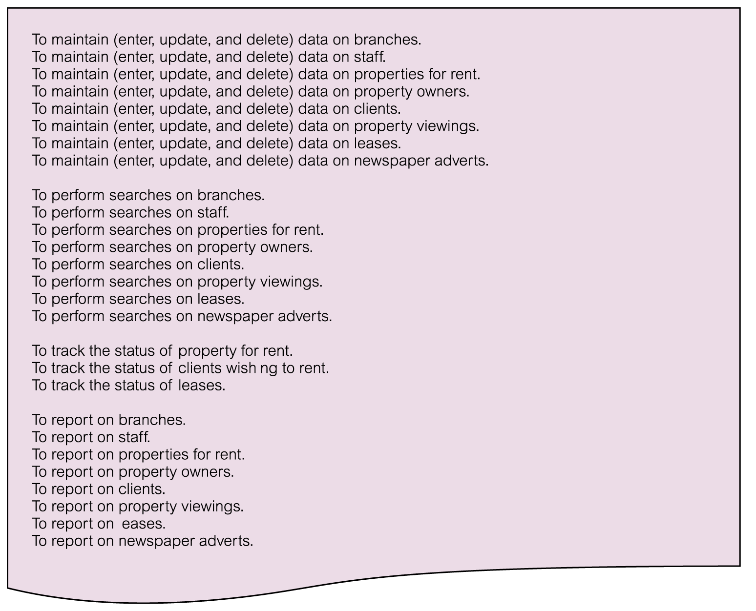
Mission Objectives for DreamHome Database System

Slide 27
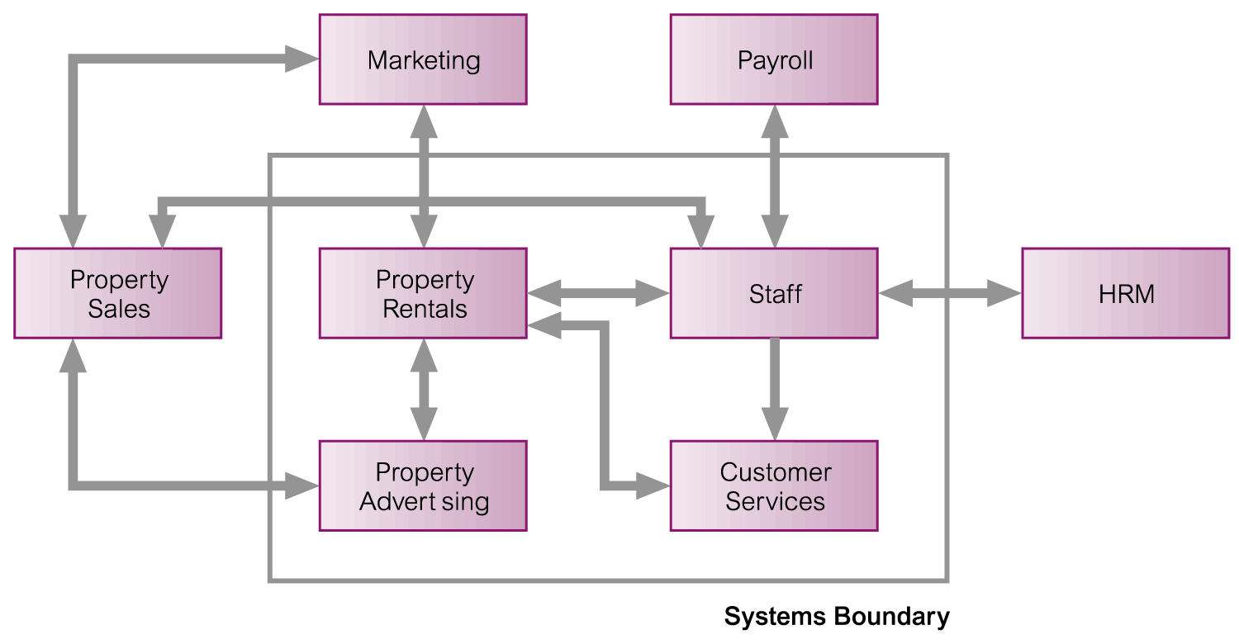
System Boundary for DreamHome Database System

Slide 28
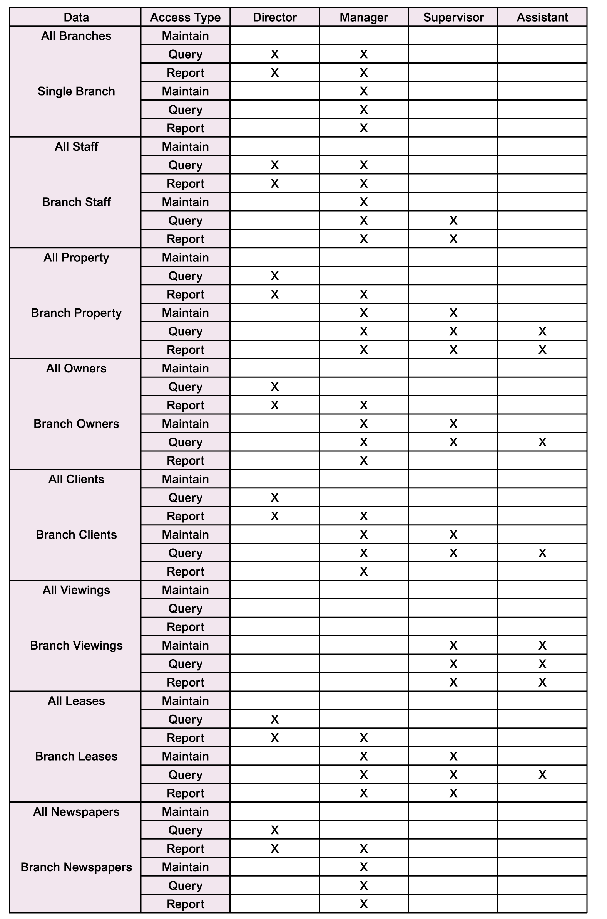
Major User Views for DreamHome Database System

Slide 29
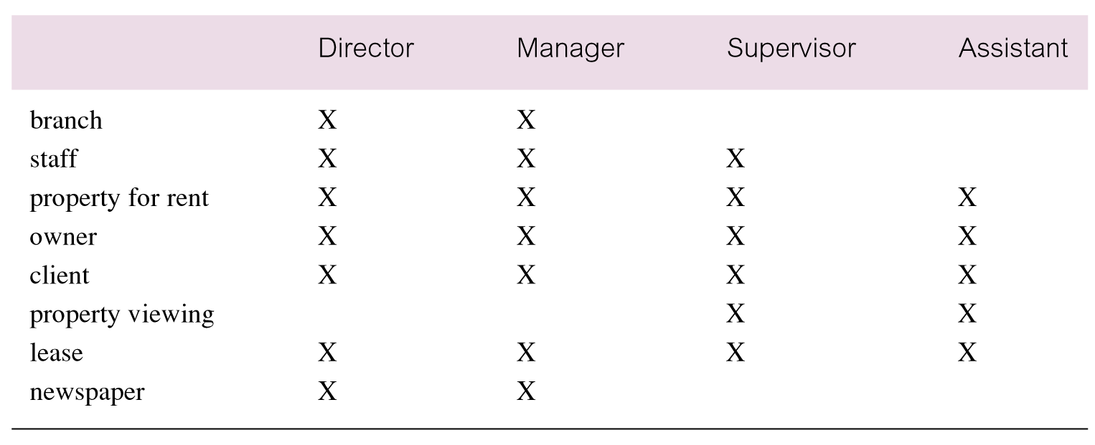
Cross-reference of user views with main types of data used by each

Slide 30

www.healthytravelblog.com

